Slide 1
Neural Machine Translation By Learning to Jointly Align and Translate
Yoshua Bengio
Dzmitry Bahdanau
KyungHyun Cho

Slide 2
What is Neural Machine Translation?
Simply put, it is the automated translation of human text from one language to another
It’s neural because we are using deep neural networks to do it, of course!
The usual gold standard for translation tasks is a huge freely available parallel corpus of English and French sentences

Slide 3
The “Old” Way of Doing Neural Machine Translation
Sutskever (2013) and Cho (2014) showed that neural networks could effectively be trained to do this task
These models relied on an encoder-decoder architecture, whereby sentences in a source language were encoded into a fixed length vector and then decoded from that vector into a target language
You can think of an encoder as a neural network architecture that achieves dimensionality reduction. Kind of like PCA, but even more powerful due to its ability to capture nonlinearities

Slide 4
Encode
Decode

Slide 5
Visualizing the Encoder-Decoder Framework
Input: A B C Output: W X Y Z

Slide 6
Problems with this method?
The problem with this generic encoder-decoder framework is that all sentences, regardless of size, are compressed into a fixed length vector
So, it is reasonable to think that for longer sentences you may start losing semantic information with this fixed length compression
Authors of this paper showed that longer sentence translations do indeed suffer because of this constraint
They then introduced a novel enhancement to this encoder-decoder framework that works around the fixed length vector constraint and found that it handles longer sentences much more elegantly

Slide 7
Enhanced Decoder
They modified the decoder by having an individualized context vector c(i) for each target word, rather than one single context vector c for all the target words
Intuitively, this represents a way of having the neural net focus its attention on different parts of the source sentence when translating rather then having to compress all the information into one fixed length vector

Slide 8
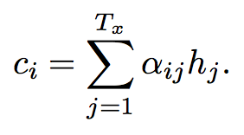
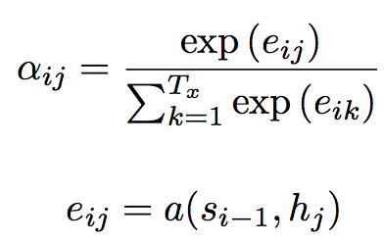
Enhanced Decoder Equations

Slide 9
Alignment Function
So let’s say we have an english sentence: “The dog is red.” And the french sentence is:
“Le chien est rouge.”

Slide 10
Enhanced Encoder
Instead of the usual RNN encoder, they modified the RNN so that the hidden states h(t) are bidirectional
They did this because they wanted the hidden states at time t to represent not only the sequence up to that point, but the sequence afterwards as well
In this way, the hidden states at time t capture a lot of information about the input word at time t, but also information about the words to the right and left of it, decreasing proportionally with sentence distance.

Slide 11
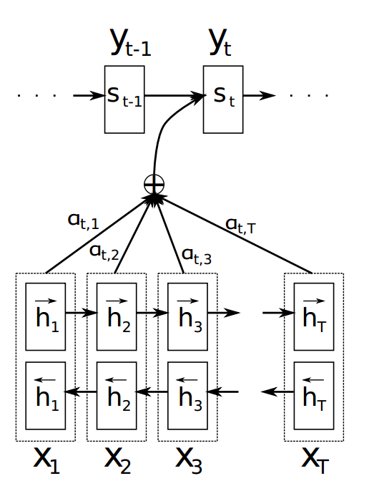
Putting it all together…
As you can see there are two big differences between this model and the older neural machine translation model
The hidden states in the encoder RNN are bidirectional now instead of simply flowing in the forward direction.
The current target word y_t is predicted based on an individualized context vector c_i that is a weighted linear combination of the encoders hidden states, instead of one single fixed context vector.

Slide 12
Results
They tested their new neural machine translation model against the older, simpler model on the standard ACL WMT dataset, which is a massive parallel corpora of french and english translations
As we will see on the next slide, the new model outperforms the old one significantly, especially for longer input sentences

Slide 13
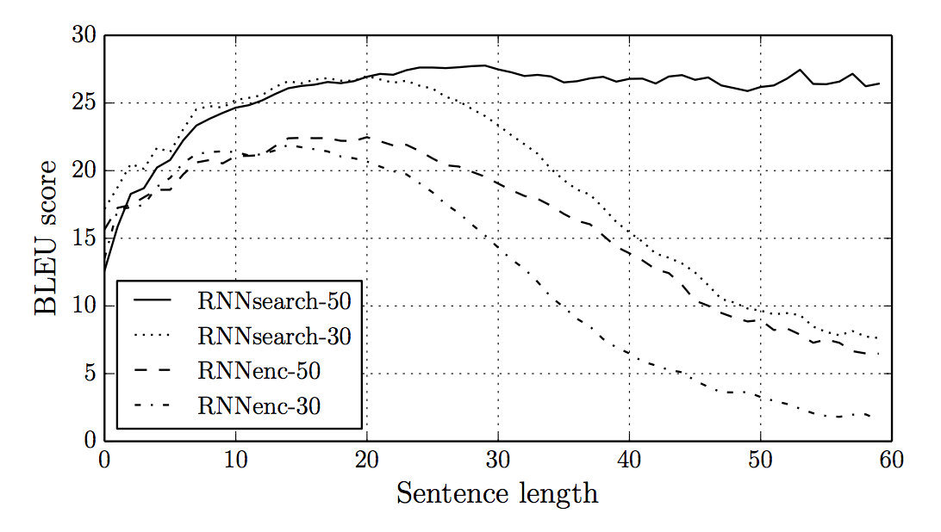
Results

Slide 14
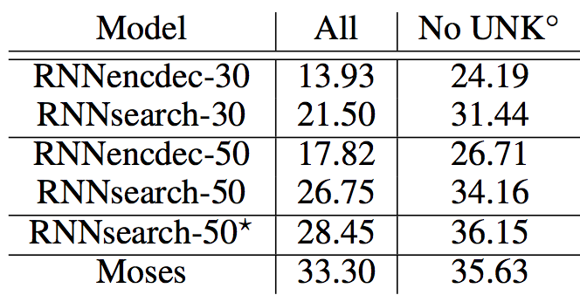
Results

Slide 15
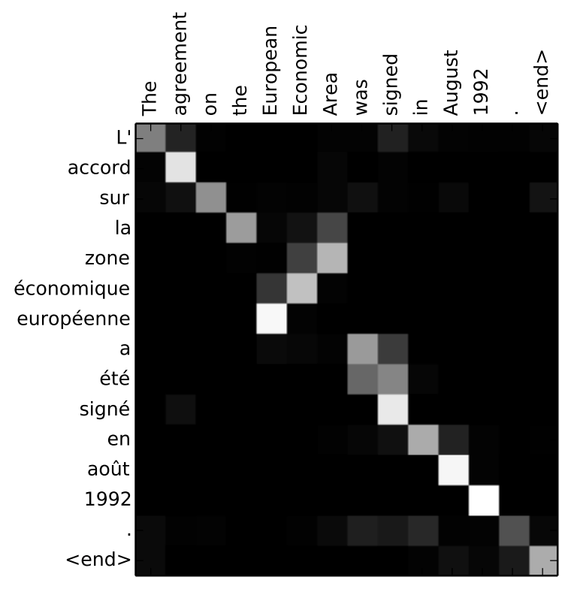
Results

Slide 16
Here’s An Example Test Sentence
An admitting privilege is the right of a doctor to admit a patient to a hospital or a medical centre to carry out a diagnosis or a procedure, based on his status as a health care worker at a hospital.

Slide 17
Here’s A Translation from the First Neural Machine Translation Model
Un privilege d’admission est le droit d’un medecin de reconnaitre un patient a` l’hopital ou un centre medical d’un diagnostic ou de prendre un diagnostic en fonction de son etat de sante.
The part underlined means “carry out a diagnosis based on his health status”. This is wrong! Original meaning was “carry out a diagnosis, based on his status as a health care worker”

Slide 18
Here’s A Translation From the New Machine Translation Model
Un privilege d’admission est le droit d’un medecin d’admettre un patient a un hopital ou un centre medical pour effectuer un diagnostic ou une procedure, selon son statut de travailleur des soins de sante a l’hopital. This is correct! (more or less)

Slide 19
Conclusion
This paper introduced novel enhancements to the encoder-decoder framework that allowed neural machine translations to be significantly more robust to longer input sentences
They achieved BLEU scores on the french-english translation task that are comparable to the state-of-the-art marks set by phrase based translation models and superior to those achieved by previous neural network based models

