Slide 1
Optimization
CU Deep Learning for Computer Vision and NLP
Liangliang Cao and James Fan
MSEE 2015 Sami Mourad
Notes:
Welcome.

Slide 2
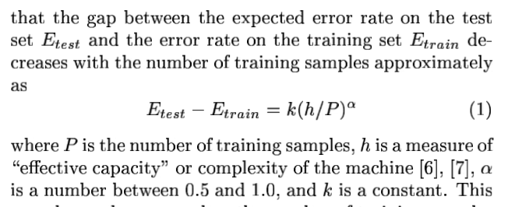
1998 LeCun
Notes:
Effective capacity is capable of decreasing both test and training error, but often results in over-fitting.
Intuitively, the neural network is a kernel that maps the input into higher dimensions. With infinitely many nodes, the network is able to satisfy any mapping from input to output that is capable of discriminating between a few different examples. How to find the one that works for all types of examples?

Slide 3
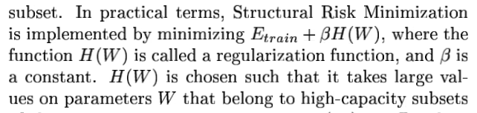
1998 LeCun
Notes:
If W is large, H(W) is very large. By making cost sensitive to large values of W, a penalty is applied for weighting certain features too heavily. This serves as a regularization of W.

Slide 4
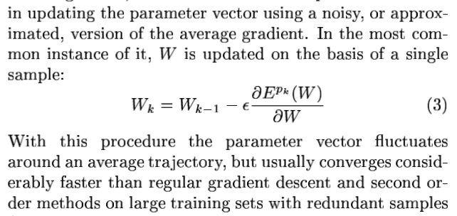
1998 LeCun
Notes:
Stochastic gradient descent considers that one example is enough to detect a direction of “descent” in the gradient (though the resulting directionality of the “descent” may exhibit favoritism towards a subset of W – i.e. where W needed adjusting the most based on this specific example, eventually – when a local minimum is reached – all entries should be adjusted properly).

Slide 5
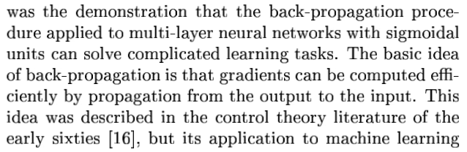
1998 LeCun
Notes:
The cascading of several non-linear functions results in a highly non-convex network function with many local minima. The presence of several local minima is not a problem in practice.
Back-propagation works…
One of the events popularizing deep learning was the demonstration that… but its application to machine learning was not generalized.

Slide 6
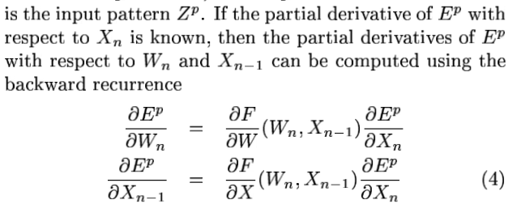
1998 LeCun
Notes:
In the first function, the partial derivative of the training error with respect to the current node’s weight is calculated by evaluating the Jacobian with respect to weights of the cost function given the input and this node’s weight times the partial with respect to the output which is known.
In the second function, the partial derivative of the training error with respect to the input is calculated by evaluating the Jacobian with respect to observations or input/output variable of the cost function given the input and the node’s weight times the partial with respect to the output which is known.
“Back-propagation” comes in when you use the result of this second function as the partial with respect to the output in the first function to calculate the partial with respect to weight in the previous node (where the current node’s input is in fact the output of the previous node).
So that’s back-propagation for you!
In particular, the F shown corresponds to the cost function referred to above, which in principle is known and chosen by the experimenter.

Slide 7
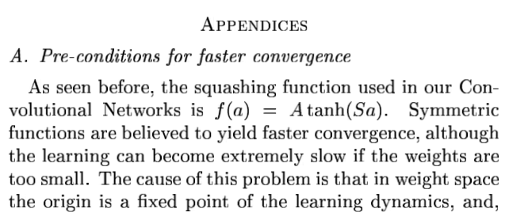
1998 LeCun
Notes:
The origin is a saddle point.
The scaled hyperbolic tangent function levels off close to inputs +/- S(pi) (where output plateaus at +/-A).

Slide 8
1998 LeCun
Notes:
If W is large, H(W) is very large. By making cost sensitive to large values of W, a penalty is applied for weighting certain features too heavily. This serves as a regularization of W.

Slide 9
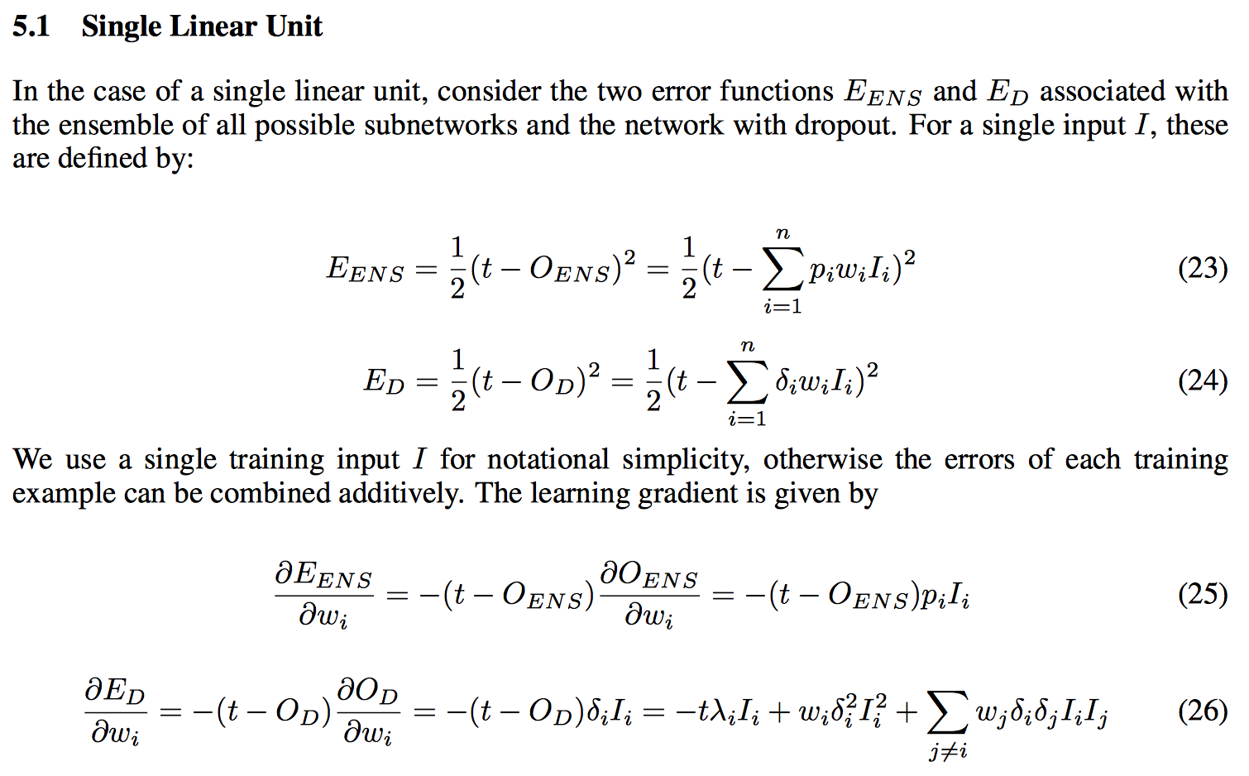
2013 Baldi & Sadowski
Notes:
The single neuron ensemble output takes into account the probability with which each input occurs (which can be seen as a fraction of the ensemble of input configurations possible).
The dropout output OD is the masked-off weighed sum of inputs. This includes input with index eye, shown in the last equation at the very end as the separate (second) term. For the first term on that side of the equation corresponding to the true output, the mask-off bit is replaced by a coefficient.

Slide 10
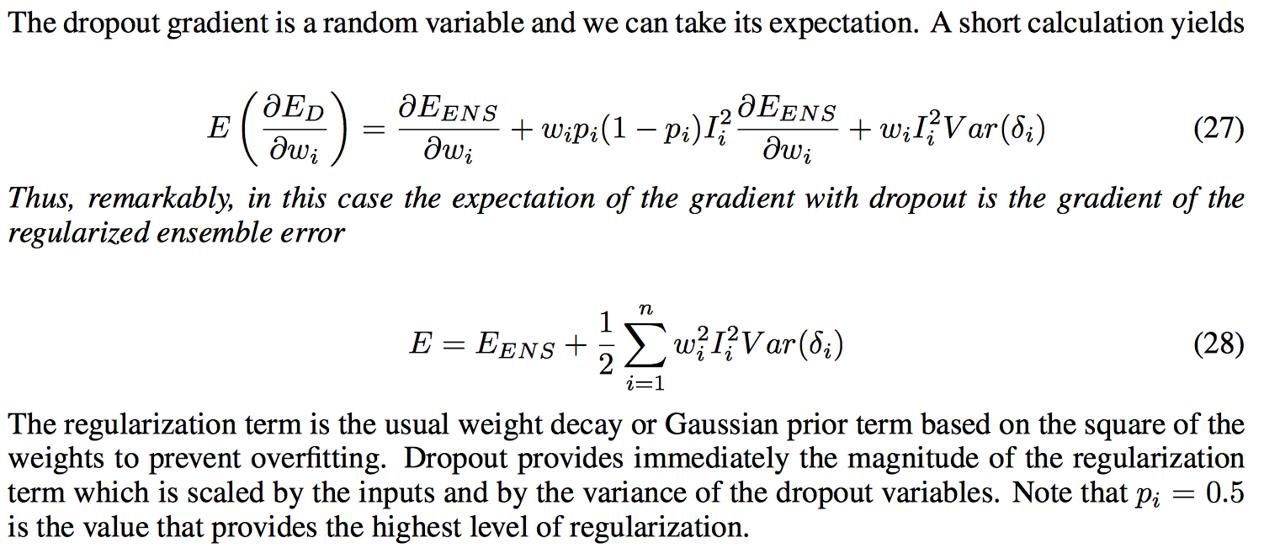
2013 Baldi & Sadowski
Notes:
Variance of Bernoulli is p * (1-p)

Slide 11
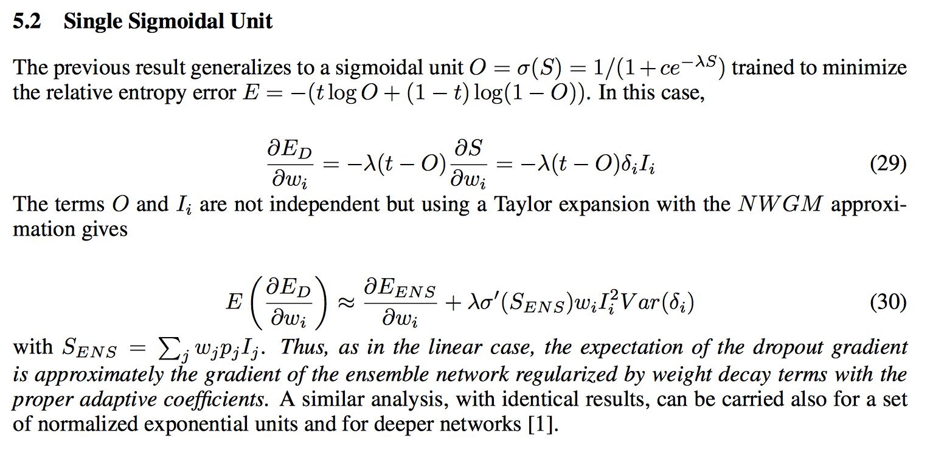
2013 Baldi & Sadowski
Notes:
For constant and logistic functions, the normalized weighed geometric mean is equal to the the expected value of the output of the unit.
The normalized weighed geometric mean is the fraction of: the geometric mean of all possible outputs weighed by their probabilities of occurrence to its sum with the geometric mean of the complement events.
By masking off different units and approximating the average of outputs thus produced, a regularization takes place as if for the entire un-bagged ensemble of sub-networks.
The above has been shown for logistic and sigmoidal hidden units. The following paper experiments with dropout using rectified linear units which either take the weighed input or 0 if the former is negative (so the process of finding the right weight can be seen as taking place on a linear function that switches on and off).

Slide 12
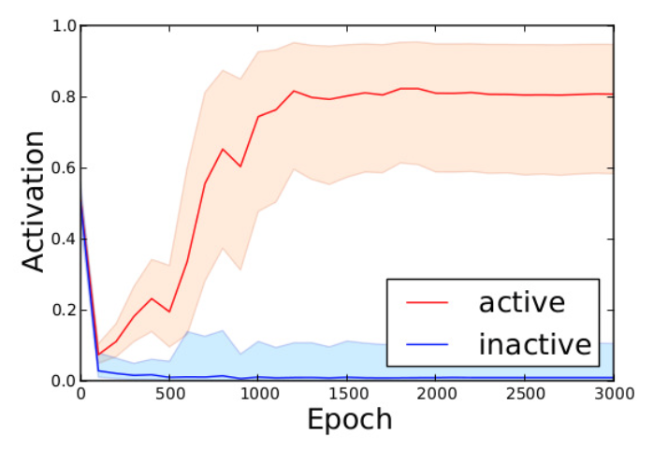
2013 Baldi & Sadowski
Notes:
The graph illustrates the specialized learning of neurons taking place, with bifurcation in the behavior of nodes between those active and inactive occurring relatively early on, and level-off once learning has occurred.

Slide 13
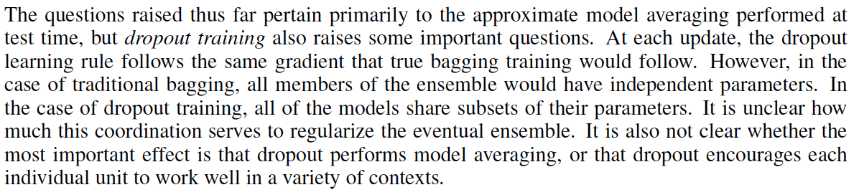
2014 Farley, Goodfellow, Courville & Bengio
Notes:
The term bagging typically is used when training is executed on all network nodes using subsets of the inputs (separately, with the output taken in average, as in dropout – so effectively smaller networks are being trained in the process). Dropout extends this technique to include all nodes of the network in the “bagging” process so that the network nodes are also trained separately on particular subsets of the input).
It is said that one important distinction between dropout and bagging is that the former shares nodes whereas the latter does not. Further, at test time, bagging takes the average of the predictions of the trained models. So it must be true then that for dropout, the masking and averaging is reserved for the training process, with the network deployed in its entirety during test time (to make proper regularized/general predictions).
When it is said that for dropout “All the models share parameters. This means that they are no longer really trained on separate subsets of the dataset”, the word subset has to do with size and should not imply a partition of the inputs. Perhaps this implies that the subsets, though taken from the same population, will produce substantially different models, in parallel. In other words, we would be running different threads of the networks trained using fixed size subsets sampled from the same pool of inputs, and then taking the average of their separate outputs.
Dropout uses a stopping criterion to avoid over-fitting and often does not reach convergence in each unit as shown otherwise in the previous slide.
- - -
This paper:
Previous: compare dropout approximate ensemble prediction by comparing against Monte Carlo estimates of the correct geometric average
1st: compare against true average in network of size small enough
Previous: bagged ensembles take average predictions via the arithmetic mean - weight scaling trick is appropriate only for geometric mean
2nd: test for disadvantage of geometric mean
Previous: is dropout different from bagging in the way it regularizes the eventual ensemble?
3rd: train independent models on re-samplings with replacement of data – train each ensemble member with single randomly sampled dropout mask fixed through entire training – combine independently trained networks into ensembles of varying size: compare to single network of identical size trained with dropout
Question: what is the experimental advantage of implementing bagging on sub-networks and combining to compare to dropout networks of the combined size? Why not compare bagging directly to dropout? Is it the expense of the computation? Really this question has more to do with – exactly how did they implement this again? What is implied by single dropout network of identical size – the size variable here is that of the ensemble - …
New criterion
4th: try biased “boosting” estimator of gradient of the geometrically averaged ensemble log likelihood, instead of stochastic gradient of random sub-network
- - -
Experimental setup:
2 hidden layers / 10 hidden units per layer / single logistic sigmoid output unit
6 binary classification problems: 4 MNIST, 2 trees, 1 2-D synthetic task
No masking of the input layer, only of the hidden layers
1: Randomly sample 50 sets of hyper-parameters (learning rate, momentum, batch-size) and train 50 networks with dropout
2: Compute activities of network corresponding to each of the 2^20 dropout masks, for each test point (implies necessarily for each test input vector)
3: Geometrically average predictions by arithmetically averaging all values of input to sigmoid output unit (i.e. the activities for each dropout mask for each test point)
Compute geometric average prediction for each point in test set (using the geometric-arithmetic averages above; geometric average of output is obtained by arithmetic average of inputs) – is this the same step as above. That is the question. It is. That is my answer.
4: Compare misclassification rate using these predictions to the approximate, weight-scaled predictions (i.e. by the dropout technique)
Figure 1 compares exhaustive geometric mean of ensemble predictions (see 2:3 above) vs. approximate
Figure 2 compares exhaustive arithmetic and geometric mean of ensemble predictions

Slide 14
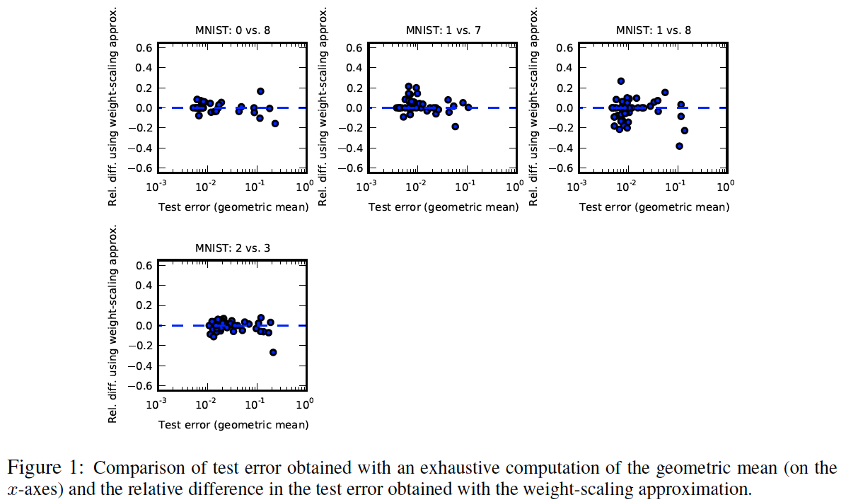
2014 Farley, Goodfellow, Courville & Bengio
Notes:
The term bagging typically is used when training is executed on all network nodes using subsets of the inputs (separately, with the output taken in average, as in dropout – so effectively smaller networks are being trained in the process). Dropout extends this technique to include all nodes of the network in the “bagging” process so that the network nodes are also trained separately on particular subsets of the input).
It is said that one important distinction between dropout and bagging is that the former shares nodes whereas the latter does not. Further, at test time, bagging takes the average of the predictions of the trained models. So it must be true then that for dropout, the masking and averaging is reserved for the training process, with the network deployed in its entirety during test time (to make proper regularized/general predictions).
When it is said that for dropout “All the models share parameters. This means that they are no longer really trained on separate subsets of the dataset”, the word subset has to do with size and should not imply a partition of the inputs. Perhaps this implies that the subsets, though taken from the same population, will produce substantially different models, in parallel. In other words, we would be running different threads of the networks trained using fixed size subsets sampled from the same pool of inputs, and then taking the average of their separate outputs.
Dropout uses a stopping criterion to avoid over-fitting and often does not reach convergence in each unit as shown otherwise in the previous slide.
- - -
This paper:
Previous: compare dropout approximate ensemble prediction by comparing against Monte Carlo estimates of the correct geometric average
1st: compare against true average in network of size small enough
Previous: bagged ensembles take average predictions via the arithmetic mean - weight scaling trick is appropriate only for geometric mean
2nd: test for disadvantage of geometric mean
Previous: is dropout different from bagging in the way it regularizes the eventual ensemble?
3rd: train independent models on re-samplings with replacement of data – train each ensemble member with single randomly sampled dropout mask fixed through entire training – combine independently trained networks into ensembles of varying size: compare to single network of identical size trained with dropout
Question: what is the experimental advantage of implementing bagging on sub-networks and combining to compare to dropout networks of the combined size? Why not compare bagging directly to dropout? Is it the expense of the computation? Really this question has more to do with – exactly how did they implement this again? What is implied by single dropout network of identical size – the size variable here is that of the ensemble - …
New criterion
4th: try biased “boosting” estimator of gradient of the geometrically averaged ensemble log likelihood, instead of stochastic gradient of random sub-network
- - -
Experimental setup:
2 hidden layers / 10 hidden units per layer / single logistic sigmoid output unit
6 binary classification problems: 4 MNIST, 2 trees, 1 2-D synthetic task
No masking of the input layer, only of the hidden layers
1: Randomly sample 50 sets of hyper-parameters (learning rate, momentum, batch-size) and train 50 networks with dropout
2: Compute activities of network corresponding to each of the 2^20 dropout masks, for each test point (implies necessarily for each test input vector)
3: Geometrically average predictions by arithmetically averaging all values of input to sigmoid output unit (i.e. the activities for each dropout mask for each test point)
Compute geometric average prediction for each point in test set (using the geometric-arithmetic averages above; geometric average of output is obtained by arithmetic average of inputs) – is this the same step as above. That is the question. It is. That is my answer.
4: Compare misclassification rate using these predictions to the approximate, weight-scaled predictions (i.e. by the dropout technique)
Figure 1 compares exhaustive geometric mean of ensemble predictions (see 2:3 above) vs. approximate
Figure 2 compares exhaustive arithmetic and geometric mean of ensemble predictions

Slide 15
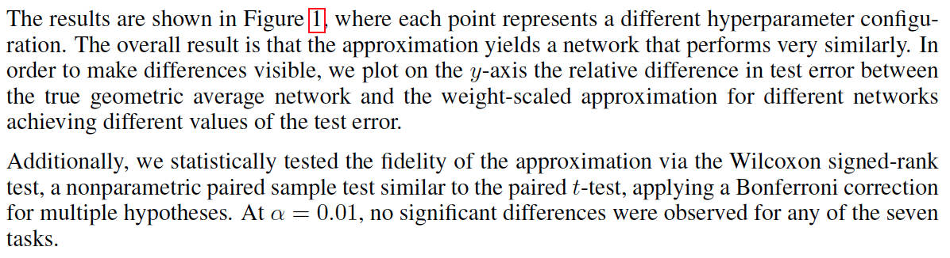
2014 Farley, Goodfellow, Courville & Bengio
Notes:
The term bagging typically is used when training is executed on all network nodes using subsets of the inputs (separately, with the output taken in average, as in dropout – so effectively smaller networks are being trained in the process). Dropout extends this technique to include all nodes of the network in the “bagging” process so that the network nodes are also trained separately on particular subsets of the input).
It is said that one important distinction between dropout and bagging is that the former shares nodes whereas the latter does not. Further, at test time, bagging takes the average of the predictions of the trained models. So it must be true then that for dropout, the masking and averaging is reserved for the training process, with the network deployed in its entirety during test time (to make proper regularized/general predictions).
When it is said that for dropout “All the models share parameters. This means that they are no longer really trained on separate subsets of the dataset”, the word subset has to do with size and should not imply a partition of the inputs. Perhaps this implies that the subsets, though taken from the same population, will produce substantially different models, in parallel. In other words, we would be running different threads of the networks trained using fixed size subsets sampled from the same pool of inputs, and then taking the average of their separate outputs.
Dropout uses a stopping criterion to avoid over-fitting and often does not reach convergence in each unit as shown otherwise in the previous slide.
- - -
This paper:
Previous: compare dropout approximate ensemble prediction by comparing against Monte Carlo estimates of the correct geometric average
1st: compare against true average in network of size small enough
Previous: bagged ensembles take average predictions via the arithmetic mean - weight scaling trick is appropriate only for geometric mean
2nd: test for disadvantage of geometric mean
Previous: is dropout different from bagging in the way it regularizes the eventual ensemble?
3rd: train independent models on re-samplings with replacement of data – train each ensemble member with single randomly sampled dropout mask fixed through entire training – combine independently trained networks into ensembles of varying size: compare to single network of identical size trained with dropout
Question: what is the experimental advantage of implementing bagging on sub-networks and combining to compare to dropout networks of the combined size? Why not compare bagging directly to dropout? Is it the expense of the computation? Really this question has more to do with – exactly how did they implement this again? What is implied by single dropout network of identical size – the size variable here is that of the ensemble - …
New criterion
4th: try biased “boosting” estimator of gradient of the geometrically averaged ensemble log likelihood, instead of stochastic gradient of random sub-network
- - -
Experimental setup:
2 hidden layers / 10 hidden units per layer / single logistic sigmoid output unit
6 binary classification problems: 4 MNIST, 2 trees, 1 2-D synthetic task
No masking of the input layer, only of the hidden layers
1: Randomly sample 50 sets of hyper-parameters (learning rate, momentum, batch-size) and train 50 networks with dropout
2: Compute activities of network corresponding to each of the 2^20 dropout masks, for each test point (implies necessarily for each test input vector)
3: Geometrically average predictions by arithmetically averaging all values of input to sigmoid output unit (i.e. the activities for each dropout mask for each test point)
Compute geometric average prediction for each point in test set (using the geometric-arithmetic averages above; geometric average of output is obtained by arithmetic average of inputs) – is this the same step as above. That is the question. It is. That is my answer.
4: Compare misclassification rate using these predictions to the approximate, weight-scaled predictions (i.e. by the dropout technique)
Figure 1 compares exhaustive geometric mean of ensemble predictions (see 2:3 above) vs. approximate
Figure 2 compares exhaustive arithmetic and geometric mean of ensemble predictions

Slide 16
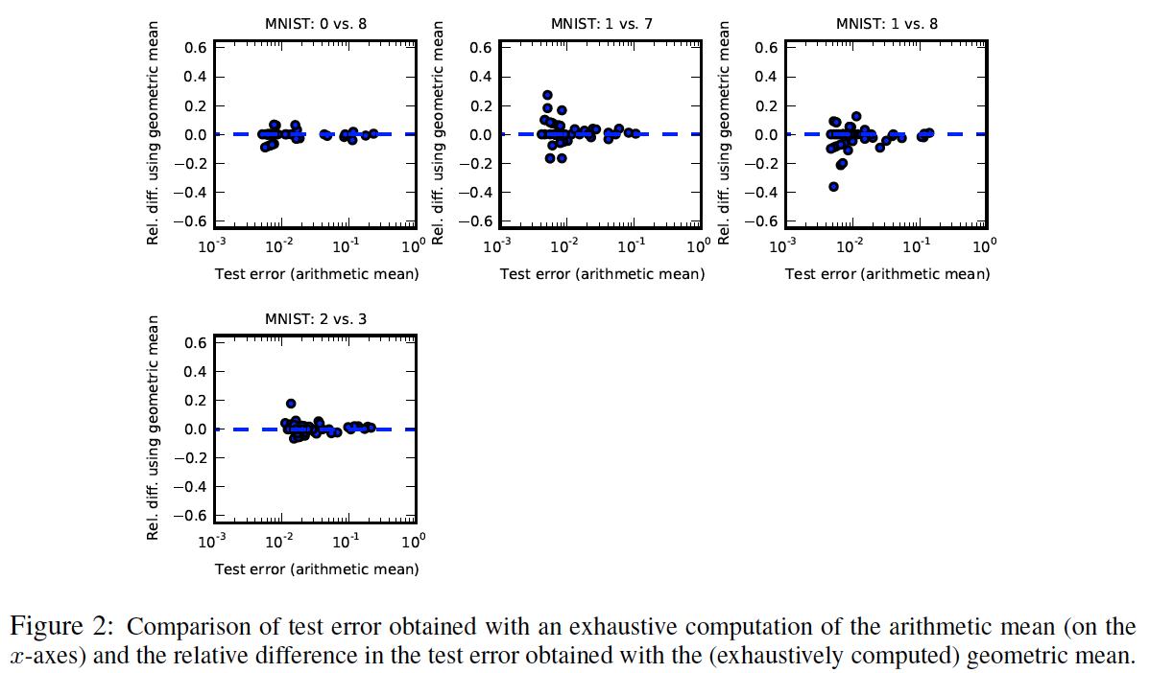
2014 Farley, Goodfellow, Courville & Bengio
Notes:
The term bagging typically is used when training is executed on all network nodes using subsets of the inputs (separately, with the output taken in average, as in dropout – so effectively smaller networks are being trained in the process). Dropout extends this technique to include all nodes of the network in the “bagging” process so that the network nodes are also trained separately on particular subsets of the input).
It is said that one important distinction between dropout and bagging is that the former shares nodes whereas the latter does not. Further, at test time, bagging takes the average of the predictions of the trained models. So it must be true then that for dropout, the masking and averaging is reserved for the training process, with the network deployed in its entirety during test time (to make proper regularized/general predictions).
When it is said that for dropout “All the models share parameters. This means that they are no longer really trained on separate subsets of the dataset”, the word subset has to do with size and should not imply a partition of the inputs. Perhaps this implies that the subsets, though taken from the same population, will produce substantially different models, in parallel. In other words, we would be running different threads of the networks trained using fixed size subsets sampled from the same pool of inputs, and then taking the average of their separate outputs.
Dropout uses a stopping criterion to avoid over-fitting and often does not reach convergence in each unit as shown otherwise in the previous slide.
- - -
This paper:
Previous: compare dropout approximate ensemble prediction by comparing against Monte Carlo estimates of the correct geometric average
1st: compare against true average in network of size small enough
Previous: bagged ensembles take average predictions via the arithmetic mean - weight scaling trick is appropriate only for geometric mean
2nd: test for disadvantage of geometric mean
Previous: is dropout different from bagging in the way it regularizes the eventual ensemble?
3rd: train independent models on re-samplings with replacement of data – train each ensemble member with single randomly sampled dropout mask fixed through entire training – combine independently trained networks into ensembles of varying size: compare to single network of identical size trained with dropout
Question: what is the experimental advantage of implementing bagging on sub-networks and combining to compare to dropout networks of the combined size? Why not compare bagging directly to dropout? Is it the expense of the computation? Really this question has more to do with – exactly how did they implement this again? What is implied by single dropout network of identical size – the size variable here is that of the ensemble - …
New criterion
4th: try biased “boosting” estimator of gradient of the geometrically averaged ensemble log likelihood, instead of stochastic gradient of random sub-network
- - -
Experimental setup:
2 hidden layers / 10 hidden units per layer / single logistic sigmoid output unit
6 binary classification problems: 4 MNIST, 2 trees, 1 2-D synthetic task
No masking of the input layer, only of the hidden layers
1: Randomly sample 50 sets of hyper-parameters (learning rate, momentum, batch-size) and train 50 networks with dropout
2: Compute activities of network corresponding to each of the 2^20 dropout masks, for each test point (implies necessarily for each test input vector)
3: Geometrically average predictions by arithmetically averaging all values of input to sigmoid output unit (i.e. the activities for each dropout mask for each test point)
Compute geometric average prediction for each point in test set (using the geometric-arithmetic averages above; geometric average of output is obtained by arithmetic average of inputs) – is this the same step as above. That is the question. It is. That is my answer.
4: Compare misclassification rate using these predictions to the approximate, weight-scaled predictions (i.e. by the dropout technique)
Figure 1 compares exhaustive geometric mean of ensemble predictions (see 2:3 above) vs. approximate
Figure 2 compares exhaustive arithmetic and geometric mean of ensemble predictions

Slide 17
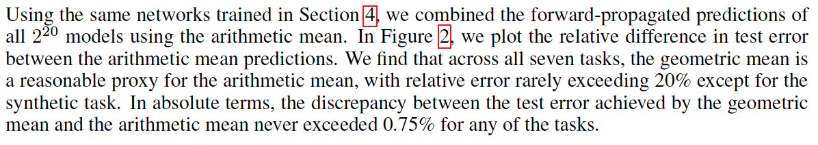
2014 Farley, Goodfellow, Courville & Bengio
Notes:
The term bagging typically is used when training is executed on all network nodes using subsets of the inputs (separately, with the output taken in average, as in dropout – so effectively smaller networks are being trained in the process). Dropout extends this technique to include all nodes of the network in the “bagging” process so that the network nodes are also trained separately on particular subsets of the input).
It is said that one important distinction between dropout and bagging is that the former shares nodes whereas the latter does not. Further, at test time, bagging takes the average of the predictions of the trained models. So it must be true then that for dropout, the masking and averaging is reserved for the training process, with the network deployed in its entirety during test time (to make proper regularized/general predictions).
When it is said that for dropout “All the models share parameters. This means that they are no longer really trained on separate subsets of the dataset”, the word subset has to do with size and should not imply a partition of the inputs. Perhaps this implies that the subsets, though taken from the same population, will produce substantially different models, in parallel. In other words, we would be running different threads of the networks trained using fixed size subsets sampled from the same pool of inputs, and then taking the average of their separate outputs.
Dropout uses a stopping criterion to avoid over-fitting and often does not reach convergence in each unit as shown otherwise in the previous slide.
- - -
This paper:
Previous: compare dropout approximate ensemble prediction by comparing against Monte Carlo estimates of the correct geometric average
1st: compare against true average in network of size small enough
Previous: bagged ensembles take average predictions via the arithmetic mean - weight scaling trick is appropriate only for geometric mean
2nd: test for disadvantage of geometric mean
Previous: is dropout different from bagging in the way it regularizes the eventual ensemble?
3rd: train independent models on re-samplings with replacement of data – train each ensemble member with single randomly sampled dropout mask fixed through entire training – combine independently trained networks into ensembles of varying size: compare to single network of identical size trained with dropout
Question: what is the experimental advantage of implementing bagging on sub-networks and combining to compare to dropout networks of the combined size? Why not compare bagging directly to dropout? Is it the expense of the computation? Really this question has more to do with – exactly how did they implement this again? What is implied by single dropout network of identical size – the size variable here is that of the ensemble - …
New criterion
4th: try biased “boosting” estimator of gradient of the geometrically averaged ensemble log likelihood, instead of stochastic gradient of random sub-network
- - -
Experimental setup:
2 hidden layers / 10 hidden units per layer / single logistic sigmoid output unit
6 binary classification problems: 4 MNIST, 2 trees, 1 2-D synthetic task
No masking of the input layer, only of the hidden layers
1: Randomly sample 50 sets of hyper-parameters (learning rate, momentum, batch-size) and train 50 networks with dropout
2: Compute activities of network corresponding to each of the 2^20 dropout masks, for each test point (implies necessarily for each test input vector)
3: Geometrically average predictions by arithmetically averaging all values of input to sigmoid output unit (i.e. the activities for each dropout mask for each test point)
Compute geometric average prediction for each point in test set (using the geometric-arithmetic averages above; geometric average of output is obtained by arithmetic average of inputs) – is this the same step as above. That is the question. It is. That is my answer.
4: Compare misclassification rate using these predictions to the approximate, weight-scaled predictions (i.e. by the dropout technique)
Figure 1 compares exhaustive geometric mean of ensemble predictions (see 2:3 above) vs. approximate
Figure 2 compares exhaustive arithmetic and geometric mean of ensemble predictions

Slide 18
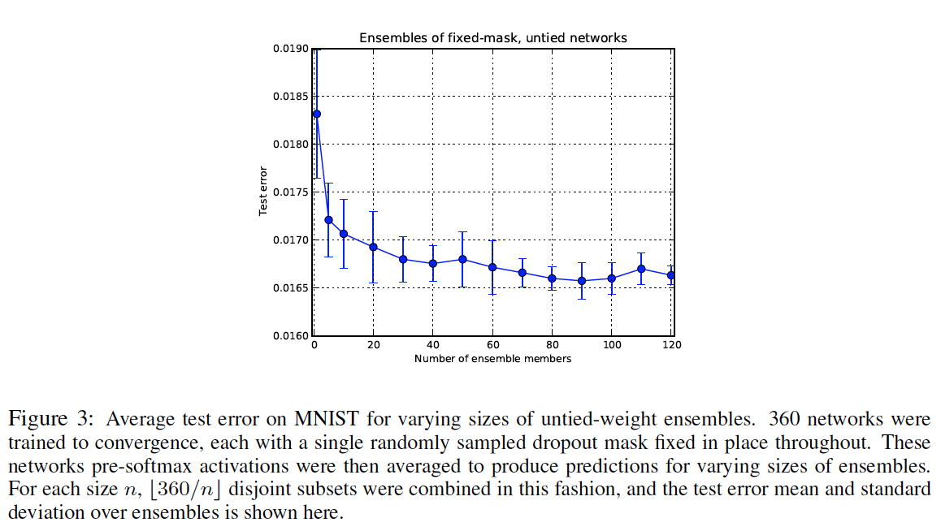
2014 Farley, Goodfellow, Courville & Bengio
Notes:
Train full size multiclass MNIST network
Two layers of RLUs
Dropout + norm constraint on weights
Add to hyper-parameters: initial ranges of weights / number of hidden units in each of two layers / maximum weight vector norms of each layer
Each gradient step taken on different mini-batch of training data / each sub-network trained on different resampling of training set, like bagging
Update using stochastic gradient descent and single ensemble member, updating weights of all ensemble members
Compare to independent networks trained with resampling of data but with dropout mask fixed throughout training
Sample 50 hyper-parameter configurations / choose network with lowest validation error (1.06% matching previous results)
Train 360 models initialized with different random seeds using traditional bagging
Instead of applying different mask at each gradient step, sample one dropout mask and hold fixed throughout training
Resulting networks have architectures sampled from same distribution as dropout sub-networks but are independent
Compare geometric mean of predictions of fixed-dropout bagging networks, with smallest test error 1.66% and dropout tuned networks with test error 1.06%

Slide 19
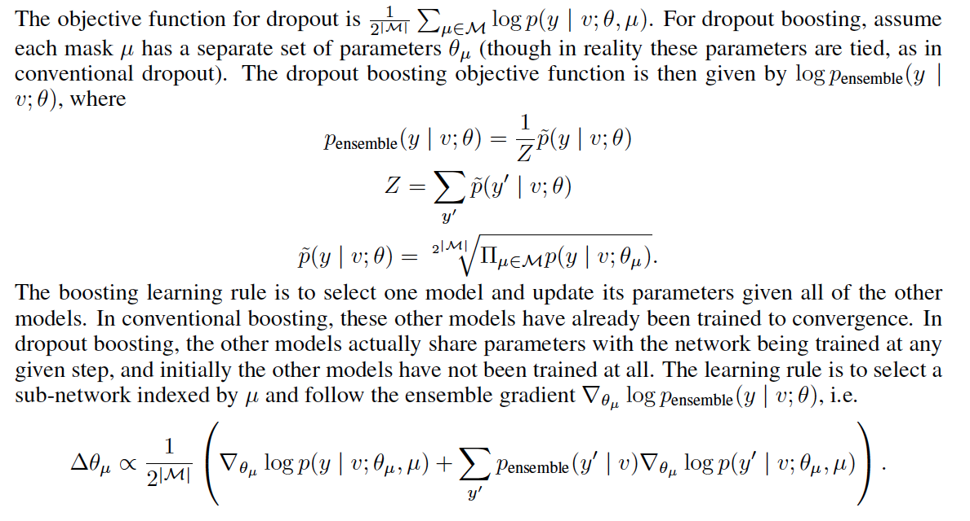
2014 Farley, Goodfellow, Courville & Bengio

Slide 20
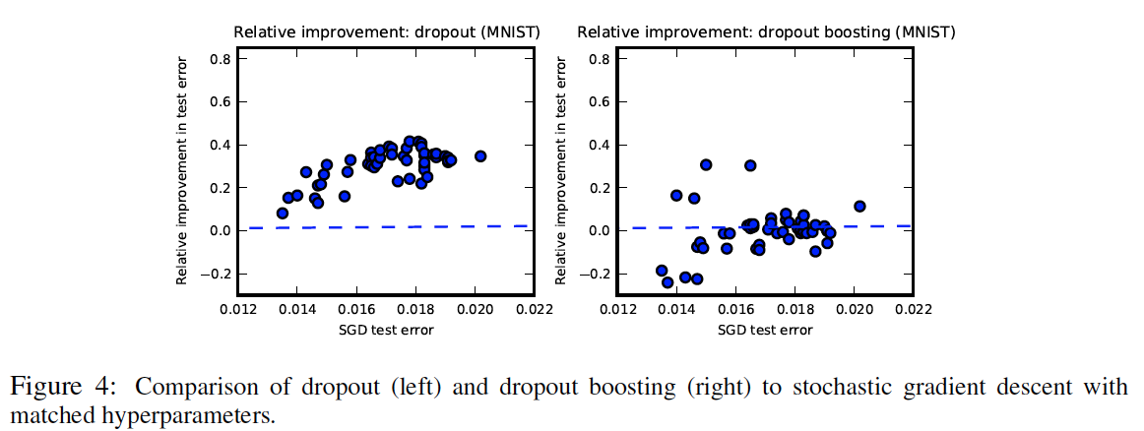
2014 Farley, Goodfellow, Courville & Bengio

Slide 21
1998 LeCun
Notes:
Stochastic gradient descent considers that one example is enough to detect a direction of “descent” in the gradient (though the resulting directionality of the “descent” may exhibit favoritism towards a subset of W – i.e. where W needed adjusting the most based on this specific example, eventually – when a local minimum is reached – all entries should be adjusted properly).

Slide 22
1998 LeCun
Notes:
The origin is a saddle point.
The scaled hyperbolic tangent function levels off close to inputs +/- S(pi) (where output plateaus at +/-A).

Slide 23
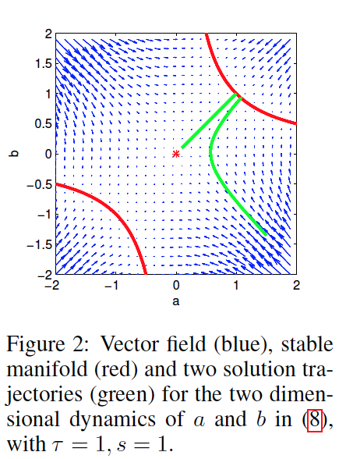
2014 Saxe
Notes:
T is proportional to size of the network.
S is proportional to the true output.
A and B are proportional to the inputs and weights respectively.
The vector field corresponds to the change of A and B with respect to one another, within the cost equations which are being minimized. So a zero represents a minimum that is undesirable. The saddle point attractor can be made out quite easily. We basically want to avoid descent in directions leading towards the zero point.
This plot is derived from the Hessian of cost given a certain set of parameters. The Hessian is a second derivative matrix. If it is indefinite or has both positive and negative eigenvalues, it indicates the presence of a saddle point. The Hessian is evaluated at input point (A,B).

Slide 24
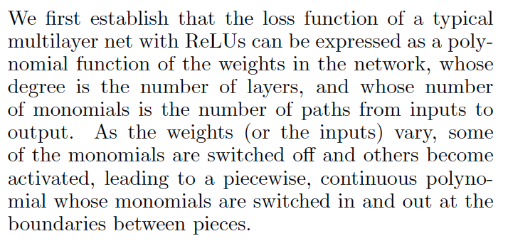
2015 LeCun

Slide 25
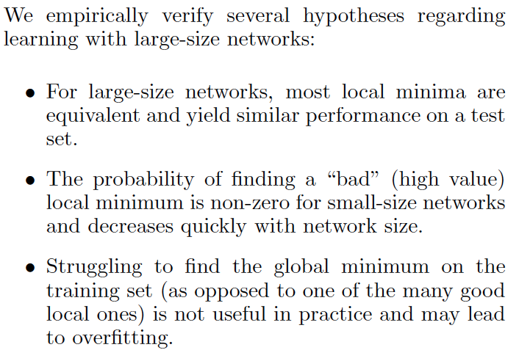
2015 LeCun

Slide 26
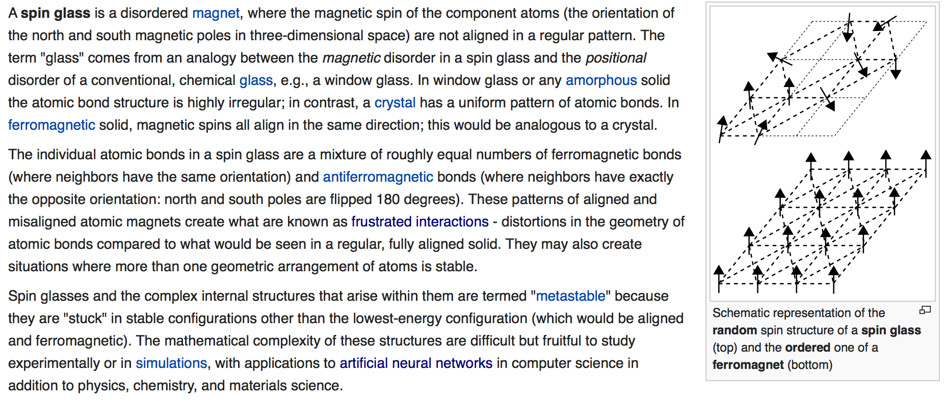
2015 LeCun
Notes:
Spin glass model of neural networks:
Assume that each input follows a path in the neural network that is completely independent from the other inputs. In reality the inputs will share paths so are not really independent – the network does contain dependencies.
Assume that the paths are all equally likely. The edges or adjacencies in the network can thus be modeled as Bernoulli random variables with the same probability of success. Have we not seen a similar idea applied in dropout ensemble networks where the inputs to a neuron were all multiplied by 0.5, the overall probability of dropout of a neuron in the network?

Slide 27
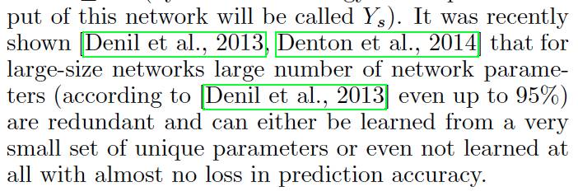
2015 LeCun
Notes:
Network parameters are redundant.
In particular, under the assumptions of:
Independence of inputs
Equally likely paths and finally, of
Redundancy
It can be shown:
Given two networks with the same configuration of edges but different weights
The correlation between the signs of the expected value of predictions of the two networks is at least:
Some function of the fraction of points that they classify differently, where
This fraction can be kept very close to 0 and the correlation made very close to 1, even if the number of weights is also small.
A further assumption is that:
With high probability, every node is adjacent to an edge with any of the unique weights arising in the graph
Under these assumptions it is shown that:
Both absolute and hinge loss equations are equivalent to the Hamiltonian of the H-spin spherical spin-glass model.
The Hamiltonian is a function of H and is given as a constant times the weighed sum of inputs with the sum of squares of the weights constrained to be equal to the H’th root of the mass of the network (where mass equals total number of paths obtained as the product of nodes in each layer)…
In the neural network, the weighed sum of inputs uses the weights obtained from cascading the input through the network (this is simply the product of weights of the nodes from each layer, since all nodes use the rectified linear unit max function).
Furthermore, the constant preceding the sum in the Hamiltonian is proportional to the normalizing factor of the network output, taken as the square root of some power of the product of number of nodes in each layer given the number of layers (where again, product of number of nodes in each layer is in fact only mass, and the H’th root of this a moment of the mass).
The Hamiltonian is the energy matrix (here calculated as loss). So the dynamics of loss can be determined by its characteristics.

Slide 28
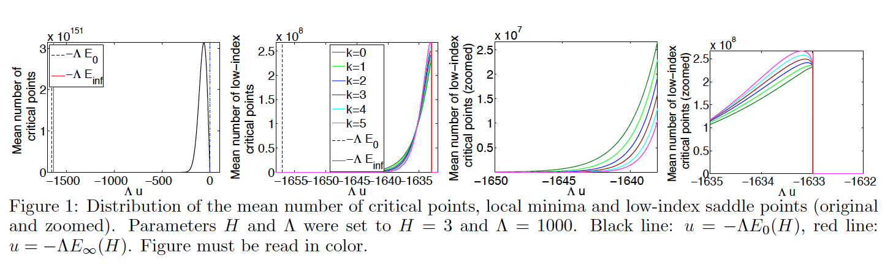
2015 LeCun
Notes:
Plot 1: the optimizer (e.g. SGD) should by all means avoid the 10^151 almost 0 energy divergent/high-index critical (saddle) points.
Plot 2: all low-index critical points lie between ground level and the energy barrier: their number increases as the energy barrier is approached.
Plots 3 and 4: shows the crossing of indexed critical-points. For a certain energy level between 0 and infinite, higher index critical points will start to over-number the lower index critical points. Local minima are those with index 0, and close to ground level are the only critical points that can be found.
It is not feasible to recover the global minimum. Why? Because the energy barrier to cross to exit the current band delimited by the energy of the current index of the local minimum and the next index, and to enter the band of another critical-point-index, is bounded below by the energy gap between the current level and ground level times the H-root-mass of the network. As the H-root-mass of the network goes to infinity, we must check how the energy gap changes as well. This however makes it infeasible to cross this energy barrier.

Slide 29
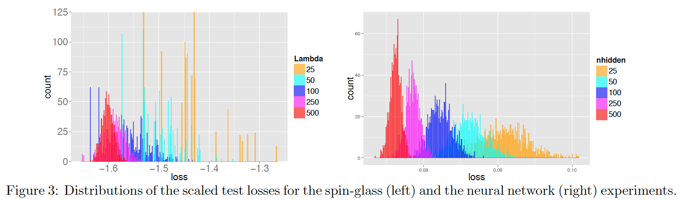
2015 LeCun
Notes:
Results (for the current and next few slides):
Test loss is concentrated over a narrower range for larger networks that is lower. For smaller networks, it is more difficult to recover the local minima in the lower energy bands. These can more easily be reached as the network size increases. As we saw, these lower bands possess a decreasing number of saddle points indexes (and thus increase in quality).
Test loss is increasingly uncorrelated with training loss for larger networks. This undoubtedly has to do with the number and nature of minimum-cost solutions.

Slide 30
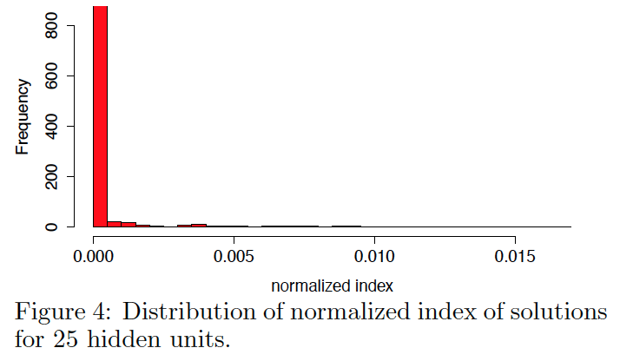
2015 LeCun

Slide 31
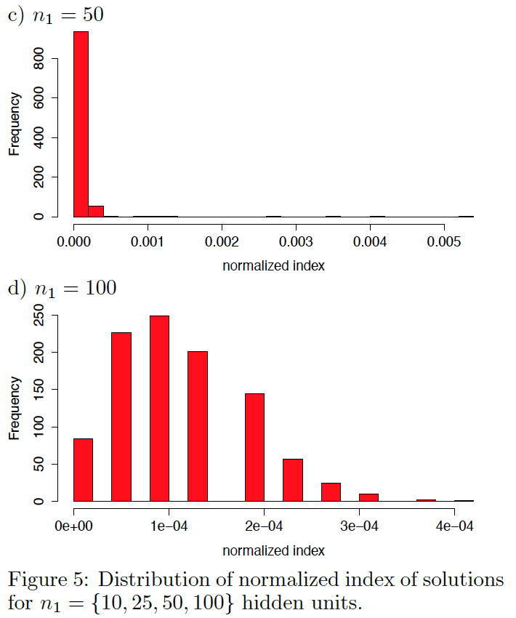
2015 LeCun

Slide 32
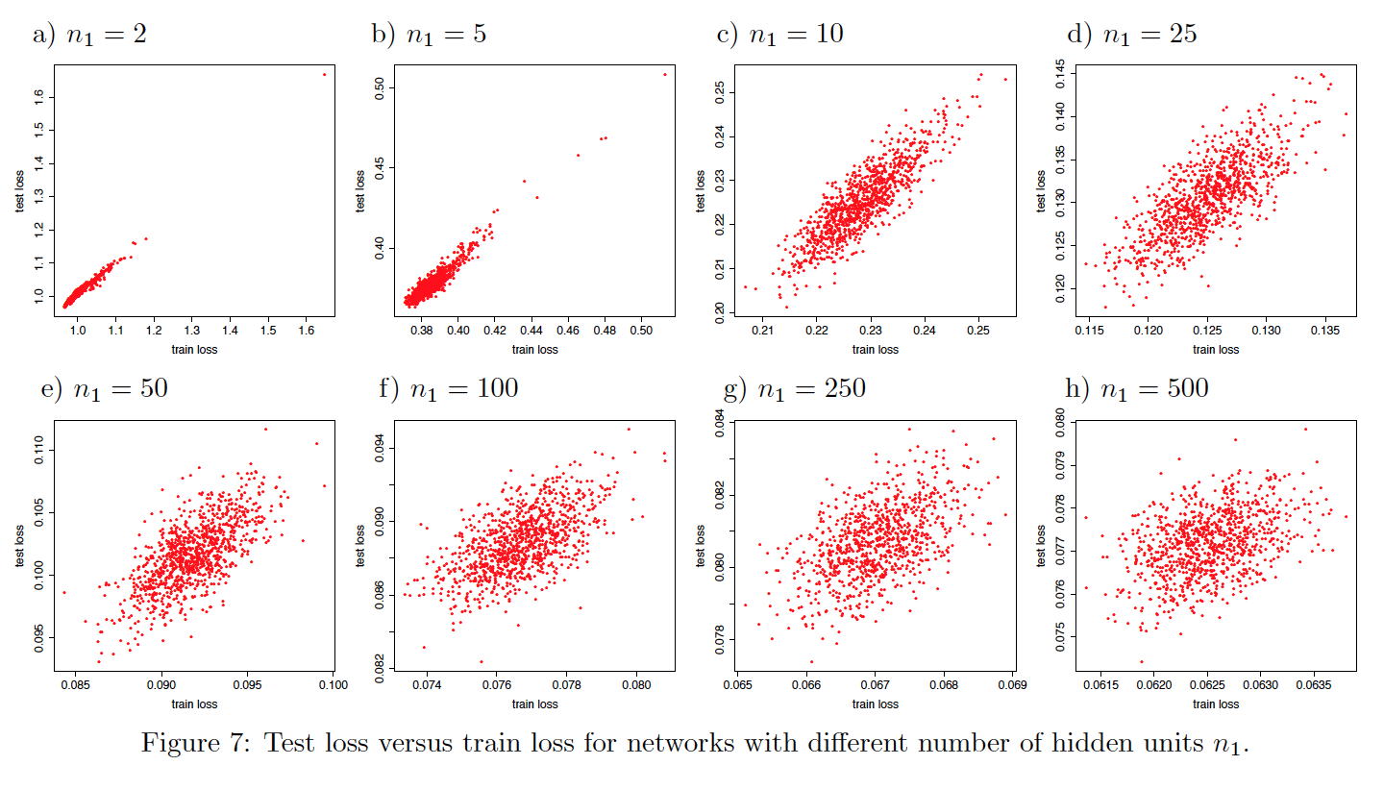
2015 LeCun

Slide 33
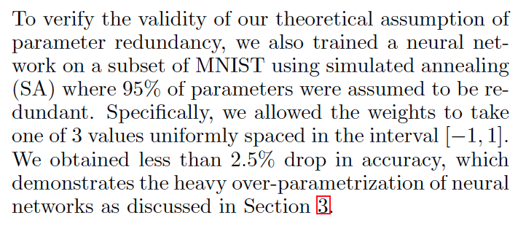
2015 LeCun
Notes:
Simulated annealing shows a drop of 2.5% in test loss compared to SGD. Simulated annealing is good at finding the global minimum. Since it does not follow the gradient, it is not likely to get stuck at local minima, which may be of high cost and thus bad quality minima in general. This shows that the performance of SGD is not significantly affected by local minima. In the contrary, local minima perform similarly to minima obtained using algorithms that are more aware of the globally optimal solution.

Slide 34
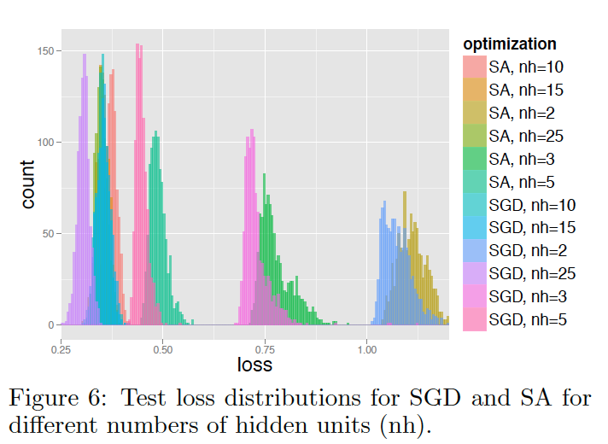
2015 LeCun

